Slide 1

MSBI LAB S21.E12-DWH
January 28, 2021

Slide 2

IN THE PREVIOUS PART
1
Implementing Indexes and Statistics
2
Query Optimizer
3
Using Tools to Analyze Query Performance
4
Execution Plans

Slide 3

S21E12 AGENDA
1
Common BI solution architecture
2
Designing and Implementing a Data Warehouse
3
Designing Dimensions
4
Designing Fact Tables

Slide 4
Common BI solution architecture

Slide 5








Common BI solution architecture
Why BI?
What happened?
What is happening?
Why did it happen?
What will happen?
What do I want to happen?
Past
Present
Future
Data
ERP
CRM
SCM
3Pty
Black books

Slide 6
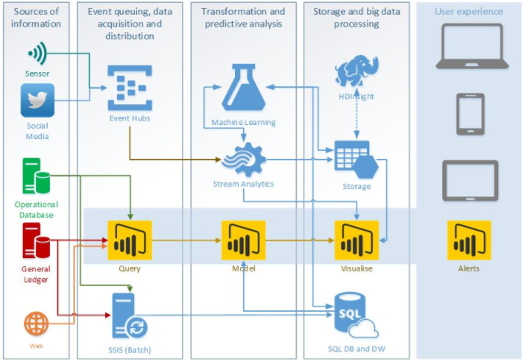
Common BI solution architecture
MS BI Architecture

Slide 7
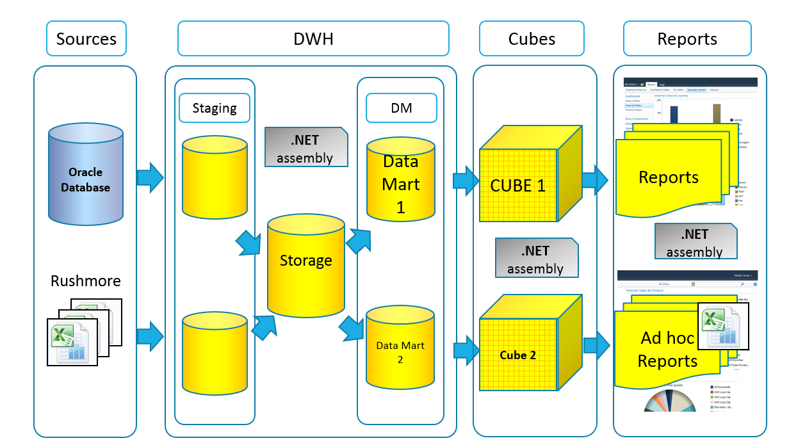
Common BI solution architecture

Slide 8
Designing and Implementing a Data Warehouse

Slide 9
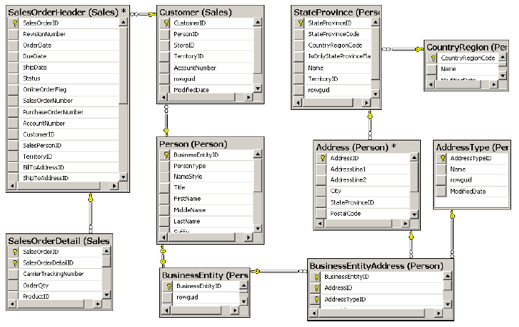
Designing and Implementing a Data Warehouse
Reporting Problems with a Normalized Schema
Comprehensive schema
Performance issues
Concurrency issues
LookUp table for Dates
Data Quality problem

Slide 10
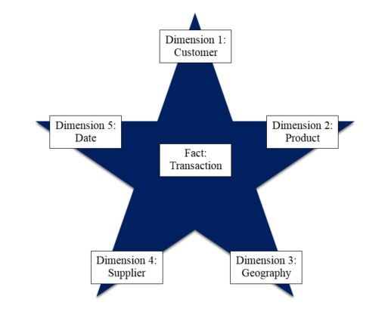
Designing and Implementing a Data Warehouse
Star Schema

Slide 11
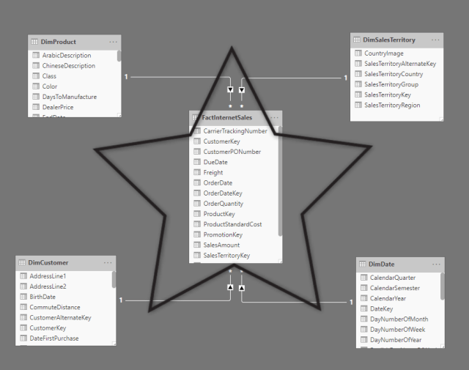
Designing and Implementing a Data Warehouse
Star Schema

Slide 12
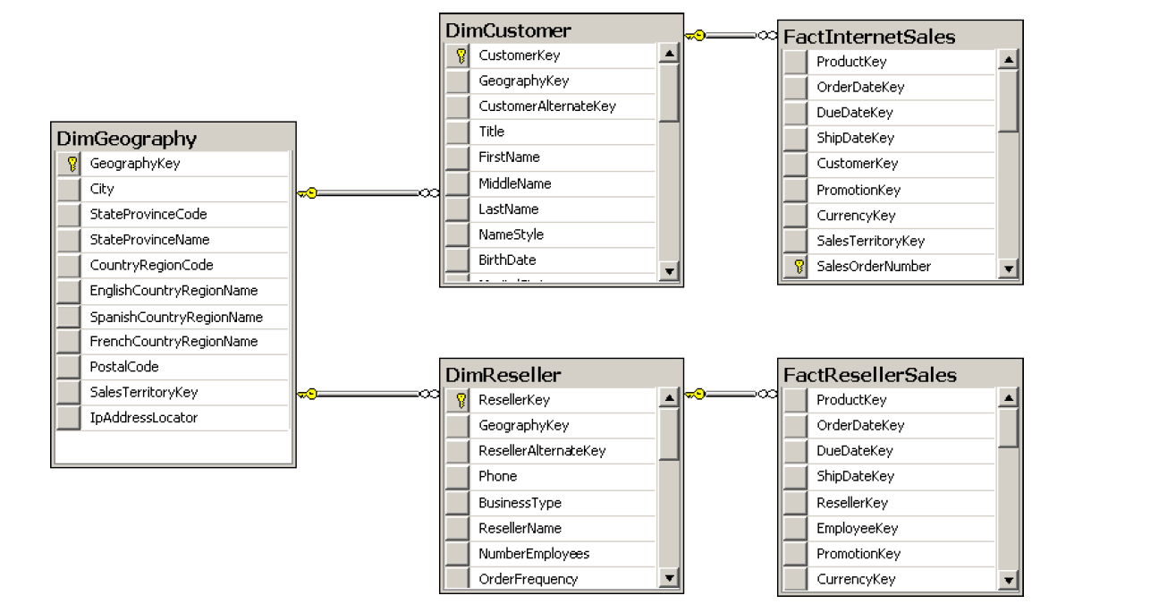
Designing and Implementing a Data Warehouse
Snowflake Schema

Slide 13
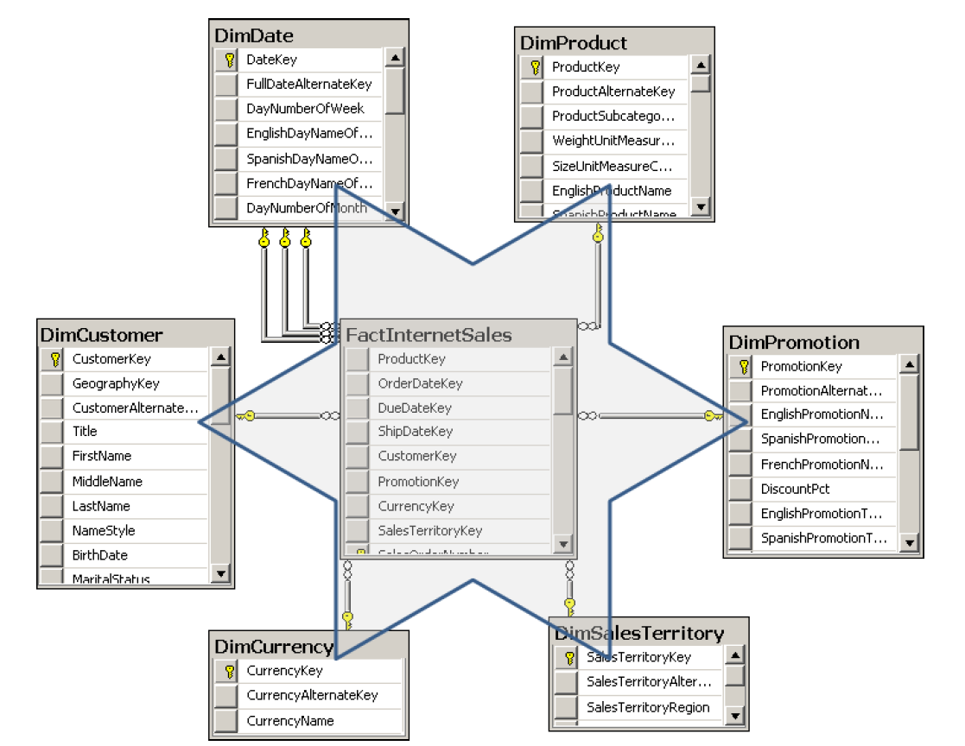
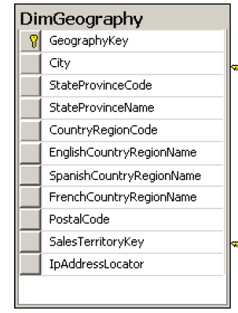
Designing and Implementing a Data Warehouse
Snowflake Schema

Slide 14
Designing and Implementing a Data Warehouse
Granularity Level
Notes:
Granularity Level
The number of dimensions connected with a fact table defines the level of granularity of
analysis you can get. For example, if no products dimension is connected to a sales fact table,
you cannot get a report at the product level—you could get a report for sales for all products
only. This kind of granularity is also called the dimensionality of a Star schema.
But there is another kind of granularity, which lets you know what level of information
a dimension foreign key represents in a fact table. Different fact tables can have different
granularity in a connection to the same dimension. This is very typical in budgeting and planning
scenarios. For example, you do not plan that customer A will come on date B to store C
and buy product D for amount E. Instead, you plan on a higher level—you might plan to sell
amount E of products C in quarter B in all stores in that region to all customers in that region.
Figure 1-7 shows an example of a fact table that uses a higher level of granularity than the
fact tables introduced so far.

Slide 15
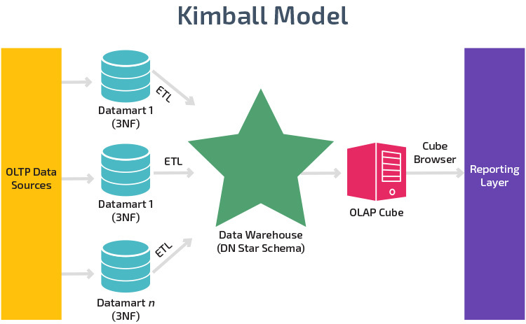
Designing and Implementing a Data Warehouse

Slide 16
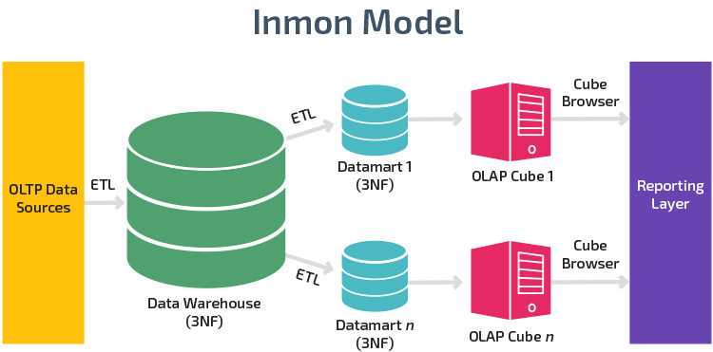
Designing and Implementing a Data Warehouse

Slide 17
Best SQL Practices for Data Warehousing

Slide 18
Best SQL Practices for Data Warehousing
Important Aspects
Avoid using constraints
Use indexes carefully
Manage statistics
Follow transaction log (use Simple recovery model on-premises)

Slide 19
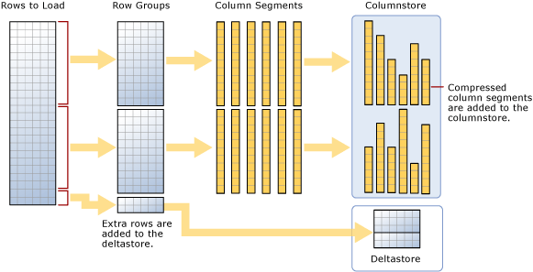
Best SQL Practices for Data Warehousing
Columnstore index

Slide 20
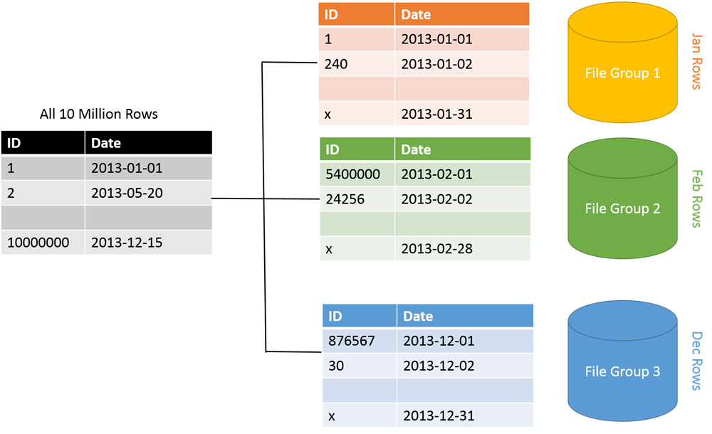
Best SQL Practices for Data Warehousing
Partition Table

Slide 21
Designing Dimensions

Slide 22
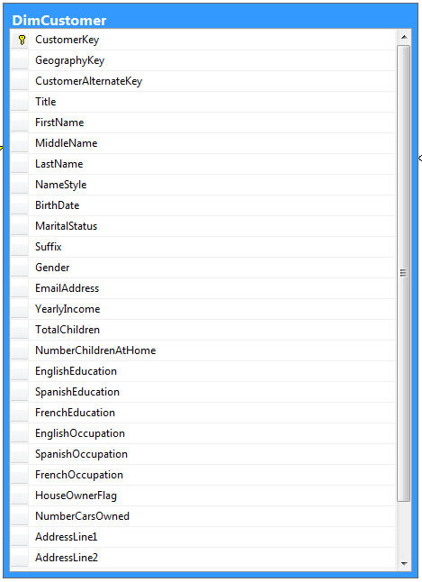
Designing Dimensions
Dimension Column Types
Keys
Used to identify entities
Name columns
Used for human names of entities
Attributes
Used for pivoting in analyses
Member properties
Used for labels in a report
Lineage columns
Used for auditing, and never exposed to end users

Slide 23
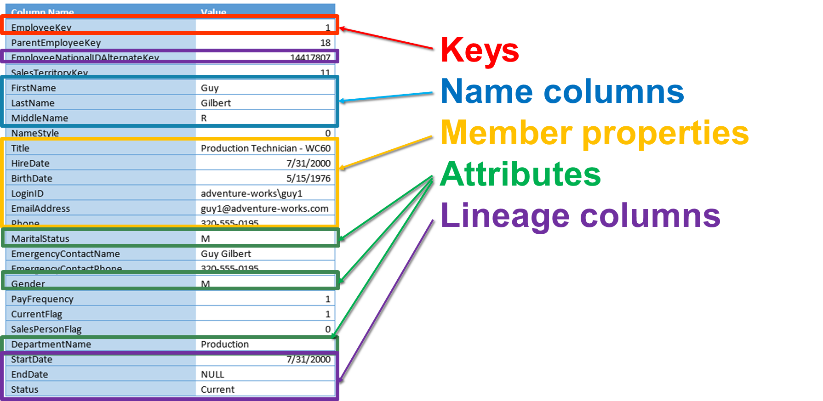
Designing Dimensions

Slide 24
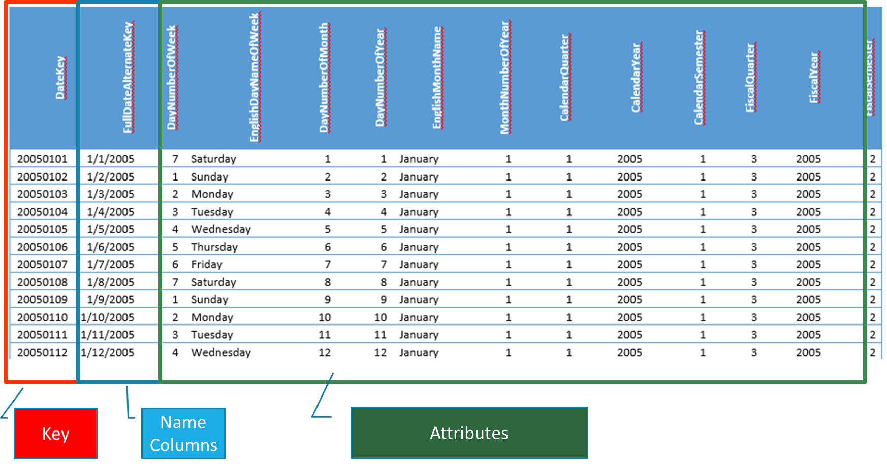
Designing Dimensions

Slide 25
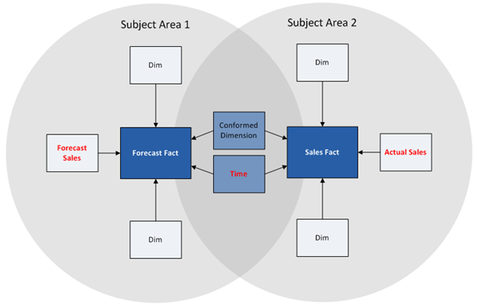
Designing Dimensions
Conformed dimension

Slide 26
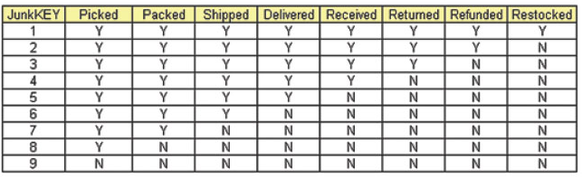
Designing Dimensions
Junk dimension

Slide 27
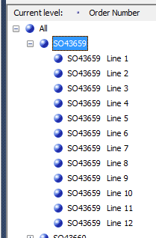
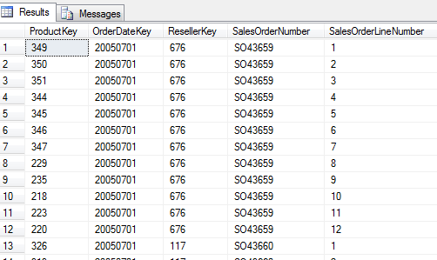
Designing Dimensions
Degenerate dimension

Slide 28
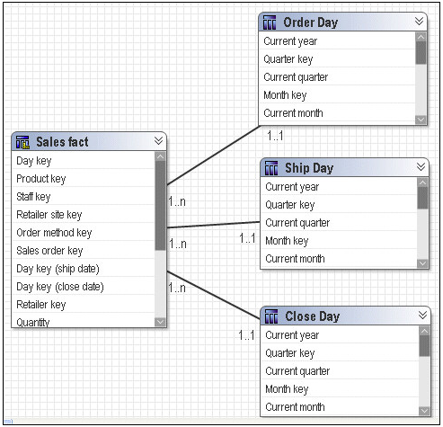
Designing Dimensions
Role-playing dimension

Slide 29
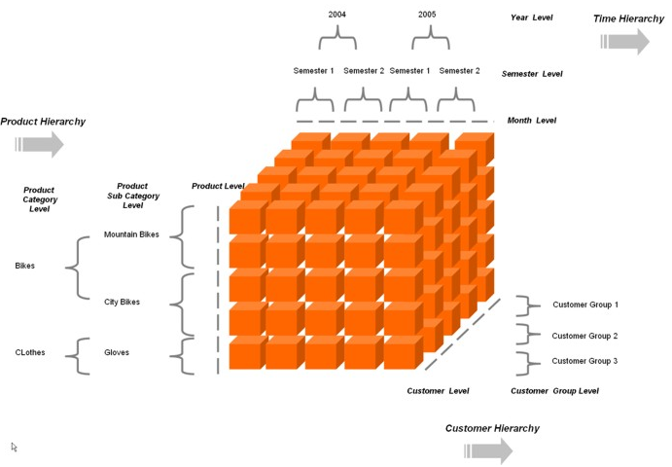
Designing and Implementing a Data Warehouse
Hierarchies

Slide 30
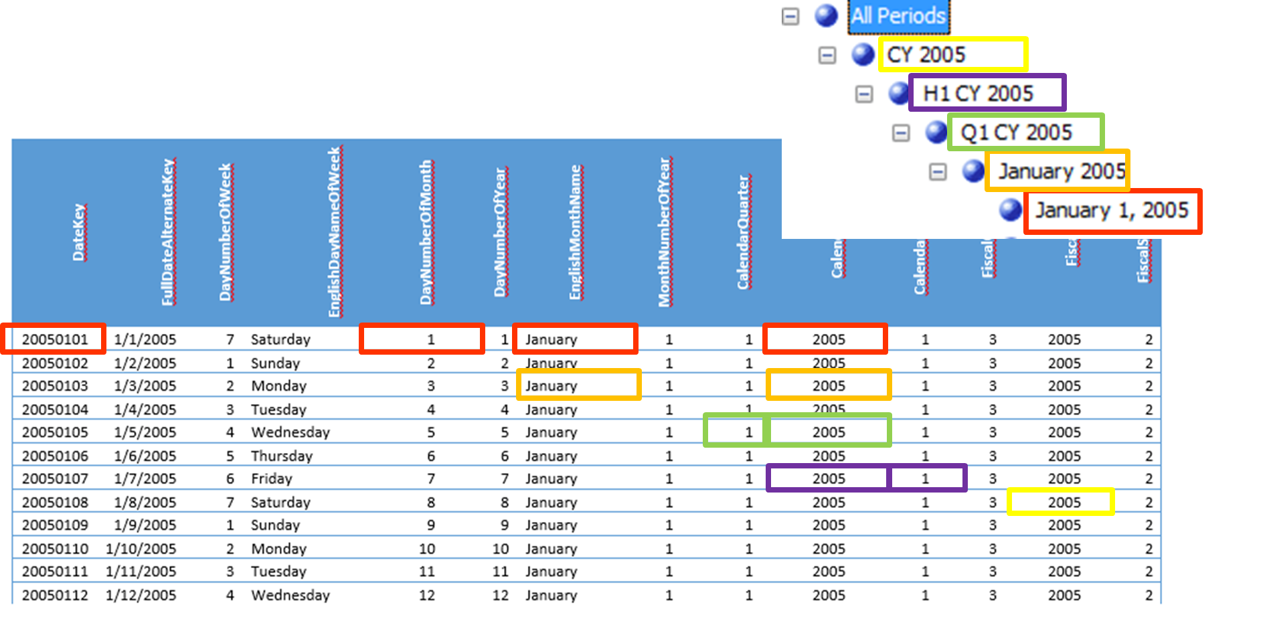
Designing Dimensions
Hierarchies

Slide 31
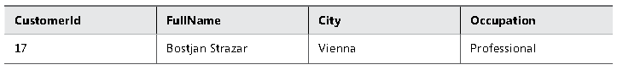
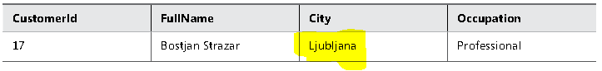
Designing Dimensions
Slowly Changing Dimension (SCD) Type 1

Slide 32
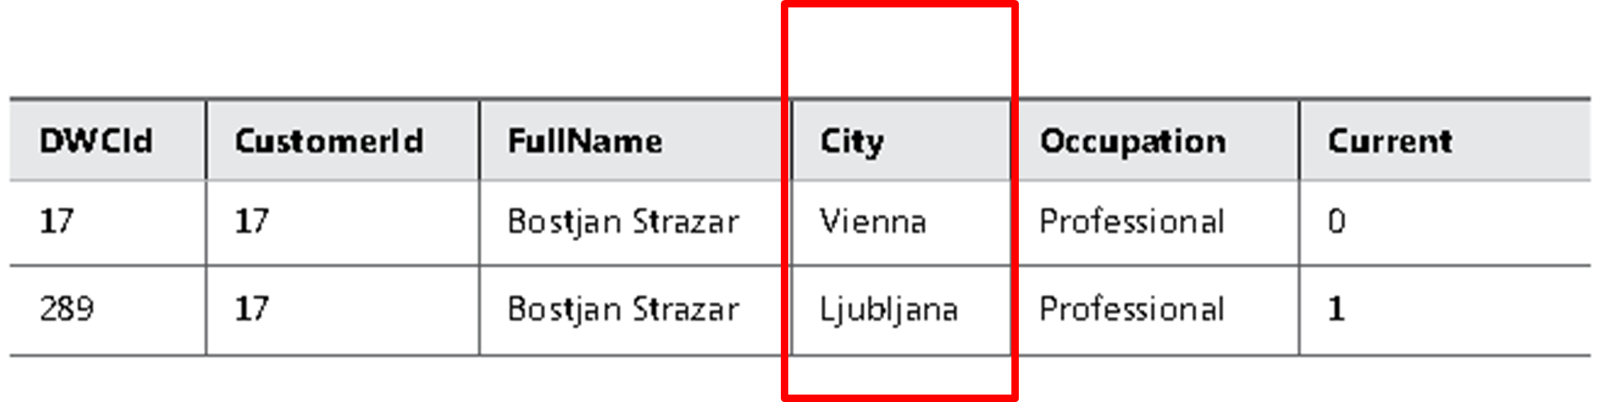
Designing Dimensions
Slowly Changing Dimension (SCD) Type 2

Slide 33
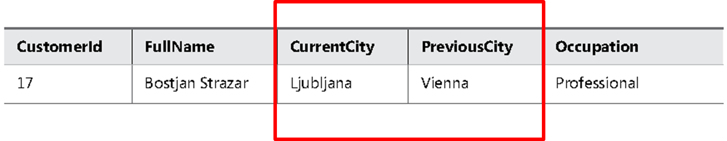
Designing Dimensions
Slowly Changing Dimension (SCD) Type 3

Slide 34
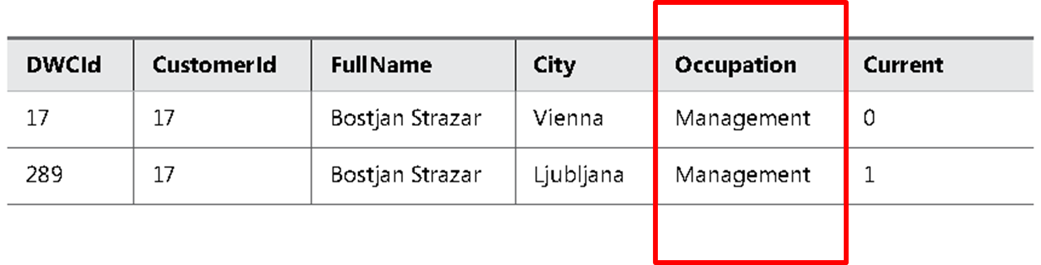
Designing Dimensions
SCD Types Mixture

Slide 35
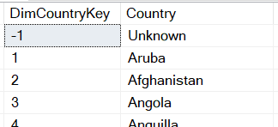
Designing Dimensions
Dummy Records

Slide 36
Designing Fact Tables

Slide 37
Designing Fact Tables
Fact Table Column Types
Foreign keys
Measures
Lineage columns
Business key columns from the primary source table (optional)

Slide 38
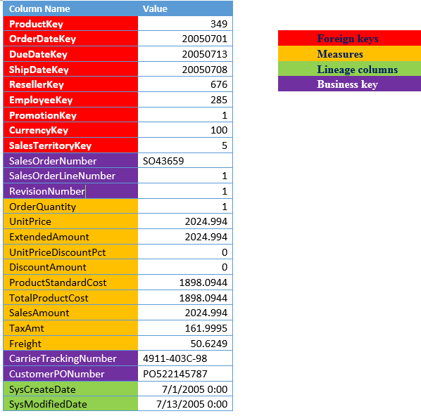
Designing Fact Tables
Fact Table Example
FactResellerSales

Slide 39
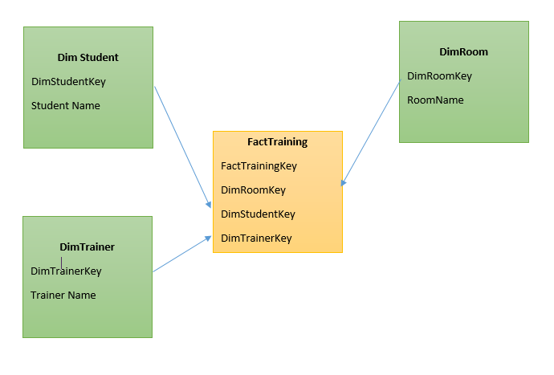
Designing Fact Tables
Factless Fact Table

Slide 40
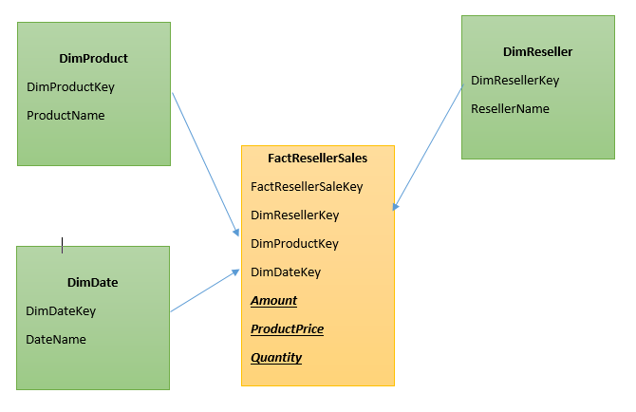
Designing Fact Tables
Transaction Fact Tables

Slide 41
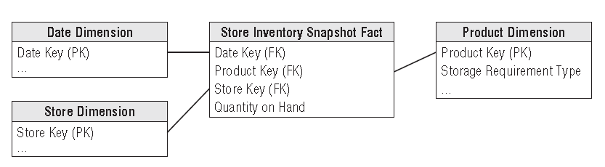
Designing Fact Tables
Periodic Snapshot Fact Tables

Slide 42
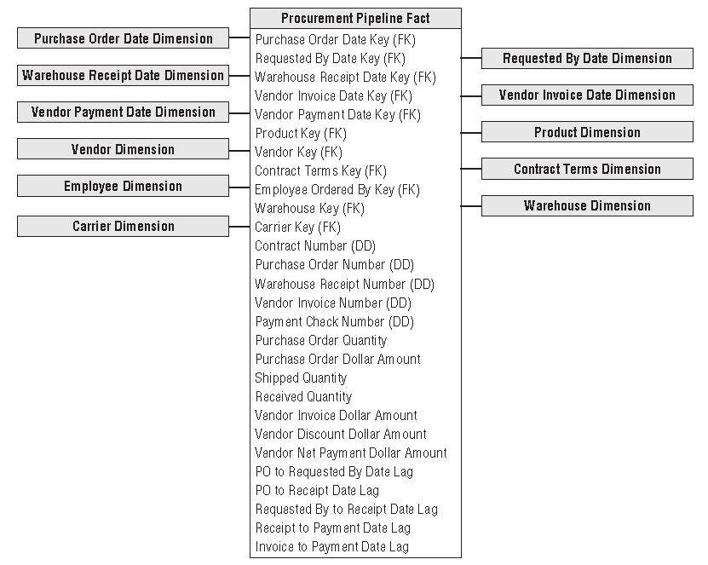
Designing Fact Tables
Accumulating Snapshot Fact Tables

Slide 43
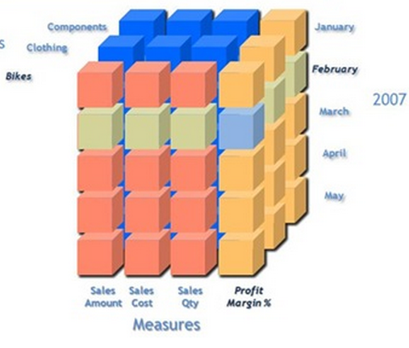
Designing Fact Tables
Measures
Additive measures
Transaction amount
Semi-Additive measures
Account balance
Non-additive measures
Price
Notes:
Let us begin with the definition of each which will be followed by examples: 1. Additive measures: These are those specific class of fact measures which can be aggreagated across all dimension and their hieracchy 2. Semi-Additive measures: These are those specific class of fact measures which can be aggreagated across all dimension and their hieracchy except the time dimension 3. Non-additive measures: These are those specific class of fact measures which cannot be aggreagated across all/any dimension and their hieracchy
A good example of a non aggregatable measure might be 'Price' on a sales record. For example: A) We have sales figures...one may tend to add sales across all quareters to avail the yearly sales..hence this is an example of Additive measure B) We have stock levels say 1000(qty of Item A) on Monday...I sell 200(qty of Item A) on Tuesday I further sell 300(qty of Item A) on Wednesday...going by basic math On Thursday I should be left with 500(qty of Item A, assuming no inventory has flown in) to obtain current stock level I cannot aggregate the Stock sales across time dimension hierarchy...If done I will have inappropriate outcomes C) Aggregation of percentage or dates is an Ideal example of non-additive measures.
Additivity of measures is not exactly a data warehouse design problem. However, you should
consider which aggregate functions you will use in reports for which measures, and which aggregate
functions you will use when aggregating over which dimension.
The simplest types of measures are those that can be aggregated with the SUM aggregate
function across all dimensions, such as amounts or quantities. For example, if sales for product
A were $200.00 and sales for product B were $150.00, then the total of the sales was $350.00.
If yesterday’s sales were $100.00 and sales for the day before yesterday were $130.00, then
the total sales amounted to $230.00. Measures that can be summarized across all dimensions
are called additive measures.
Some measures are not additive over any dimension. Examples include prices and percentages,
such as a discount percentage. Typically, you use the AVERAGE aggregate function for
such measures, or you do not aggregate them at all. Such measures are called non-additive
measures. Often, you can sum additive measures and then calculate non-additive measures
from the additive aggregations. For example, you can calculate the sum of sales amount and
then divide that value by the sum of the order quantity to get the average price. On higher

Slide 44
Practical Task

Slide 45
Practical Task

